Slide 1
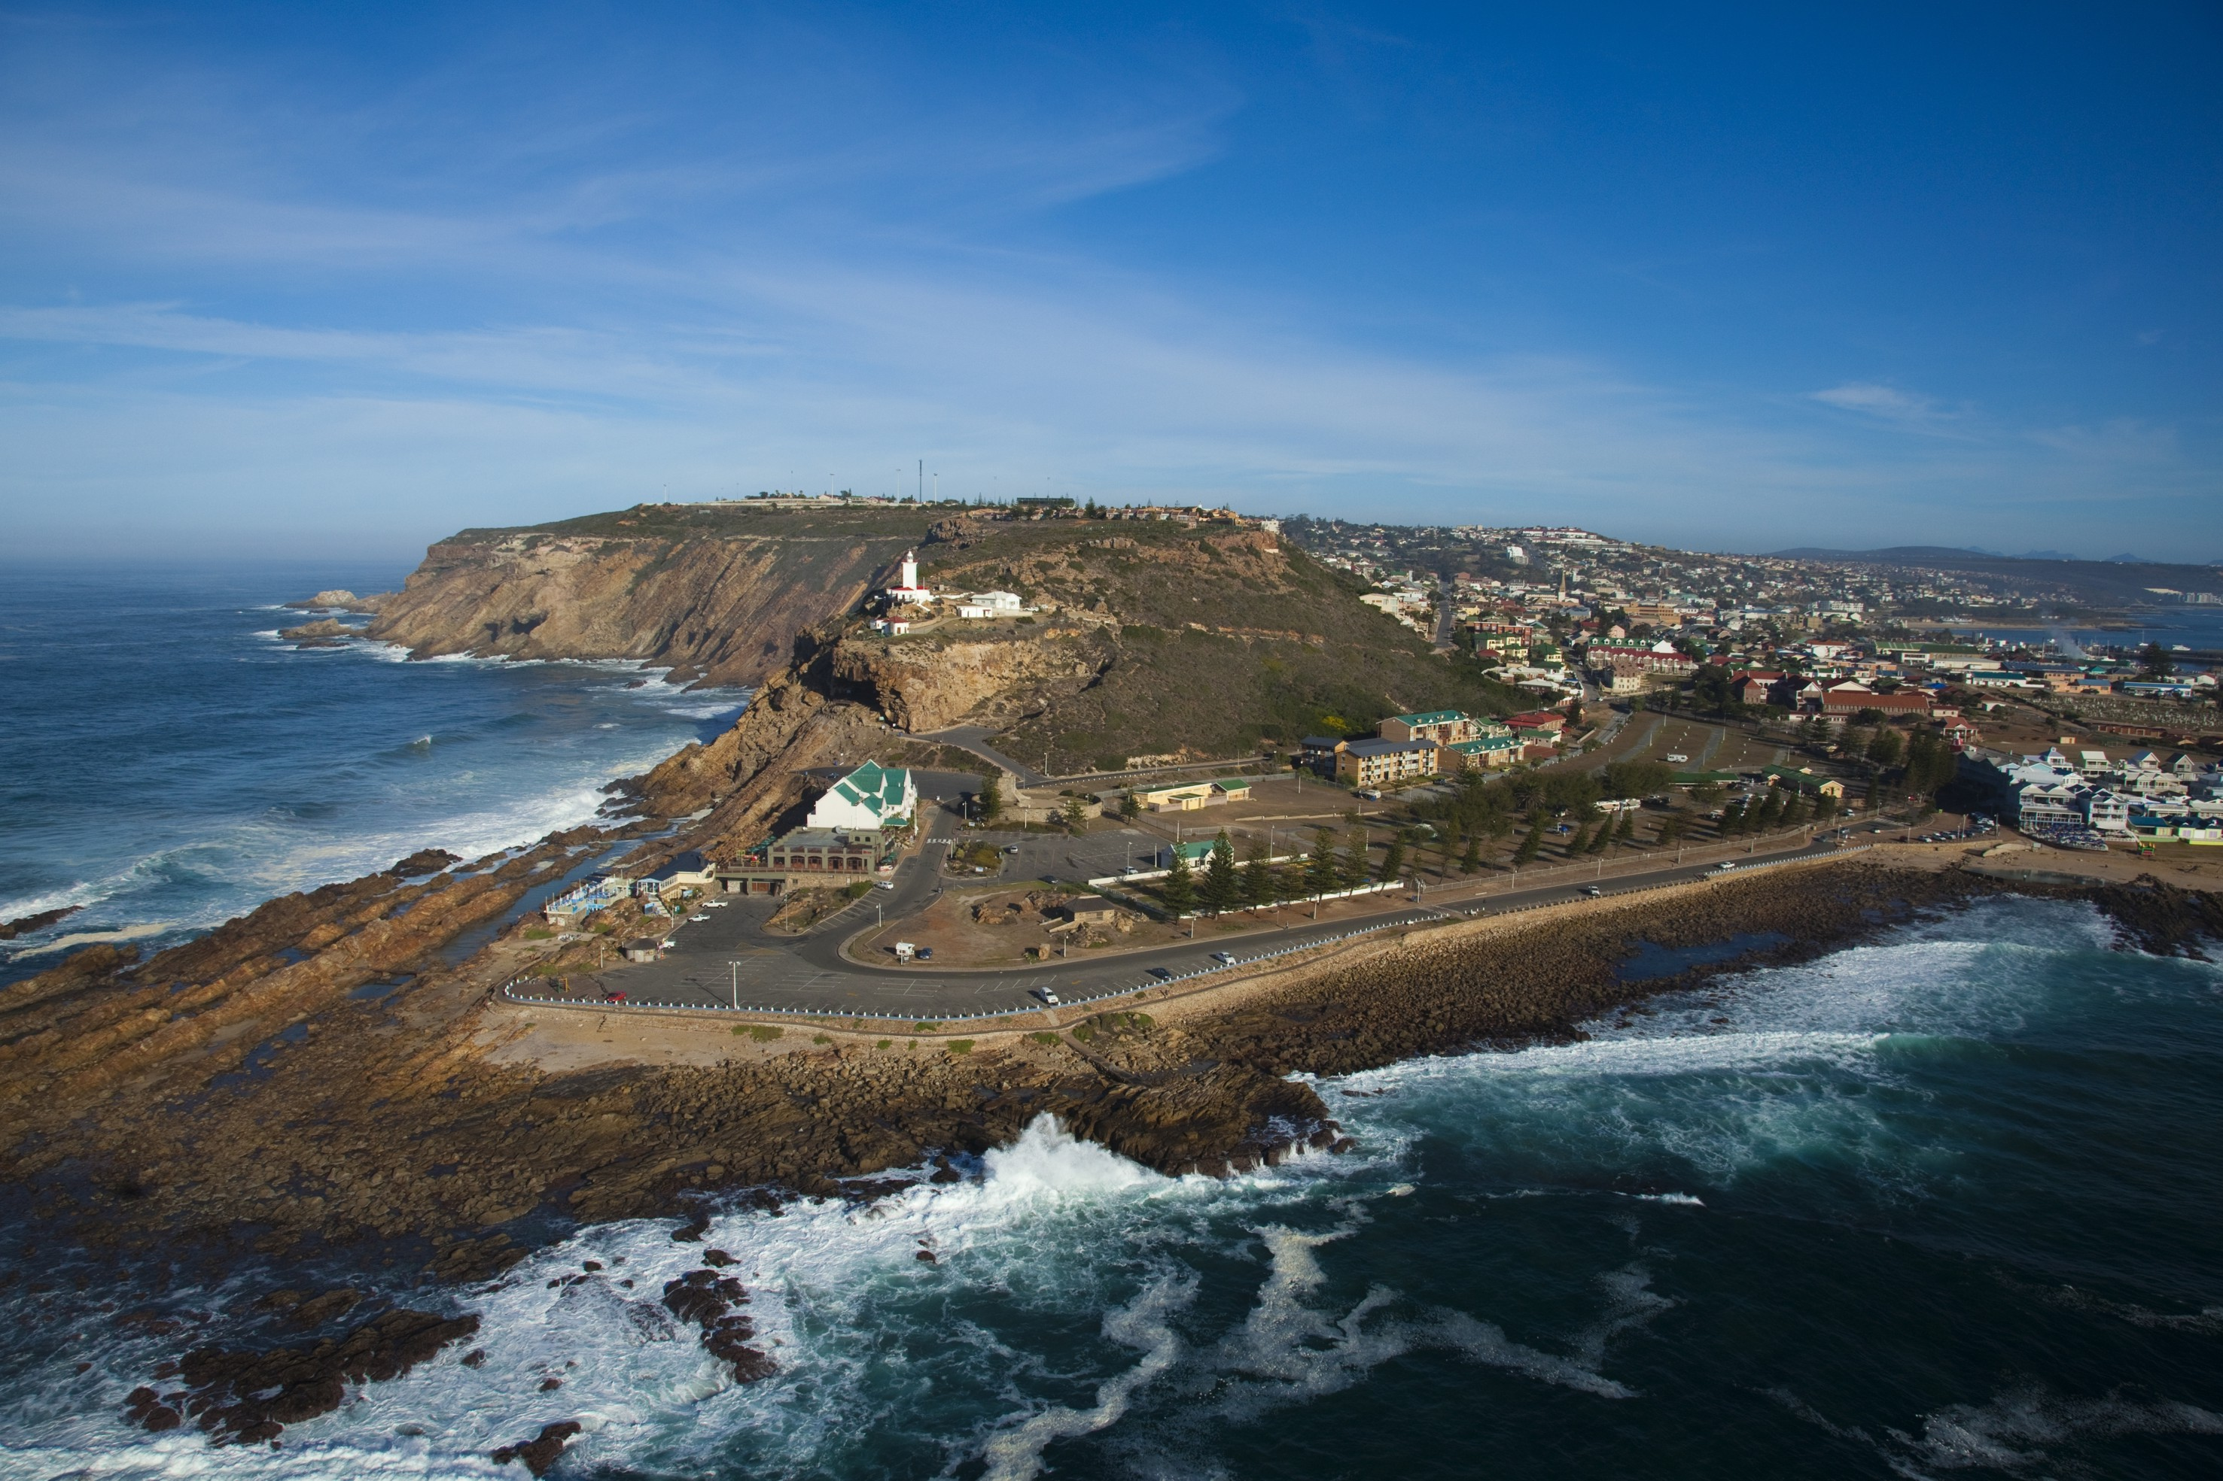
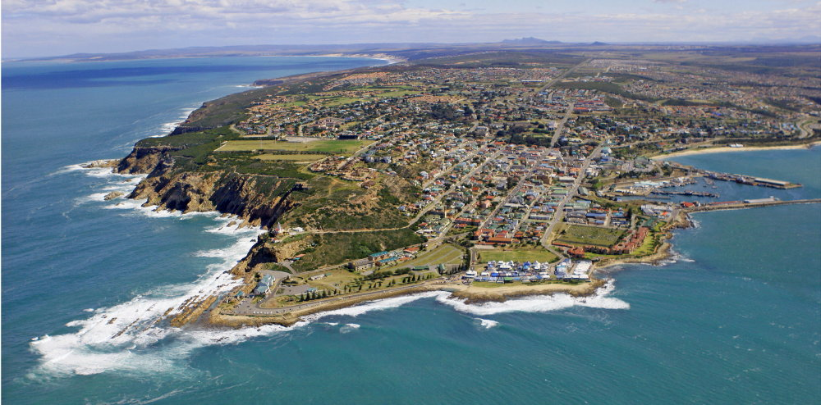
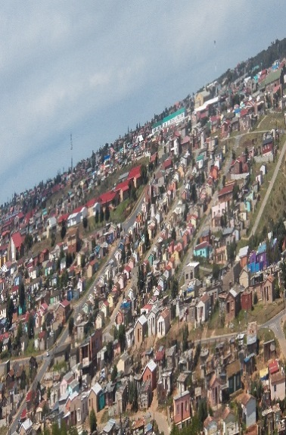
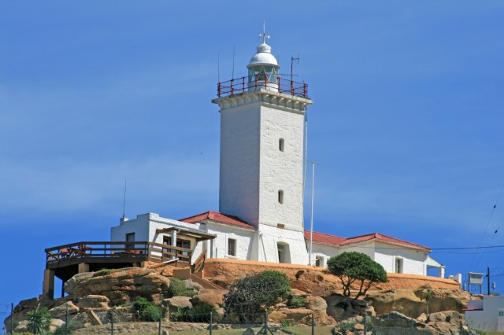
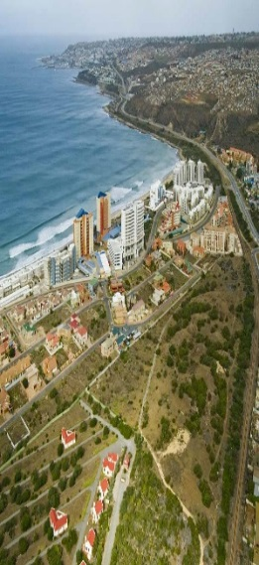
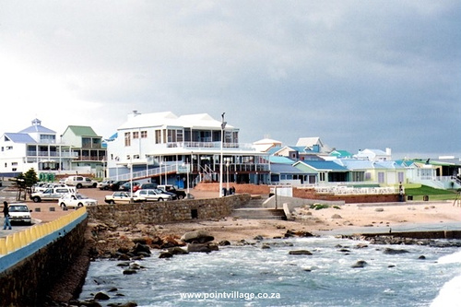

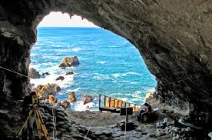
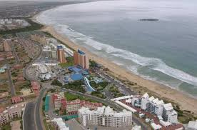
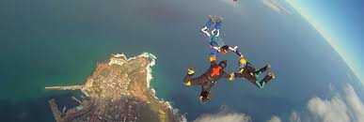
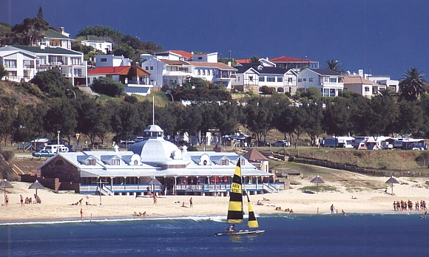
IDP REP FORUM
Date: 24 NOVEMBER 2020

Slide 2


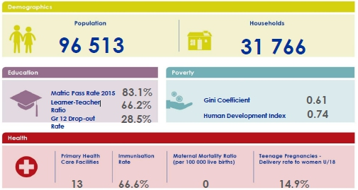
ABOUT MOSSEL BAY MUNICIPALITY

Slide 3
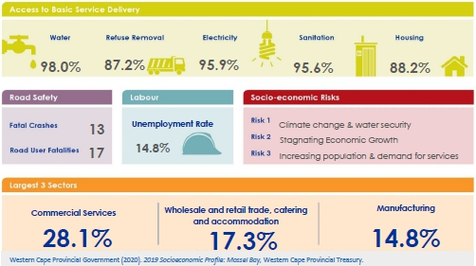
ABOUT MOSSEL BAY MUNICIPALITY

Slide 4
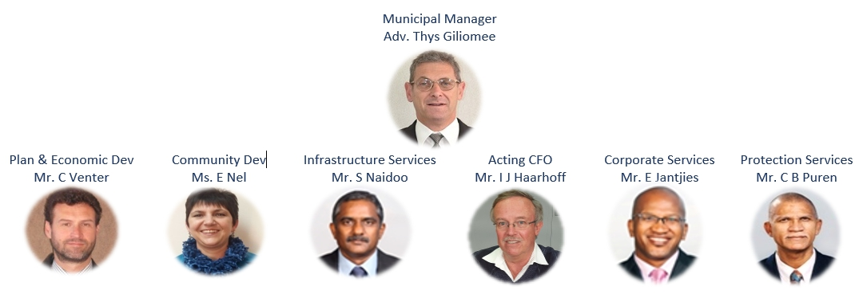
ABOUT MOSSEL BAY MUNICIPALITY
Executive Management

Slide 5
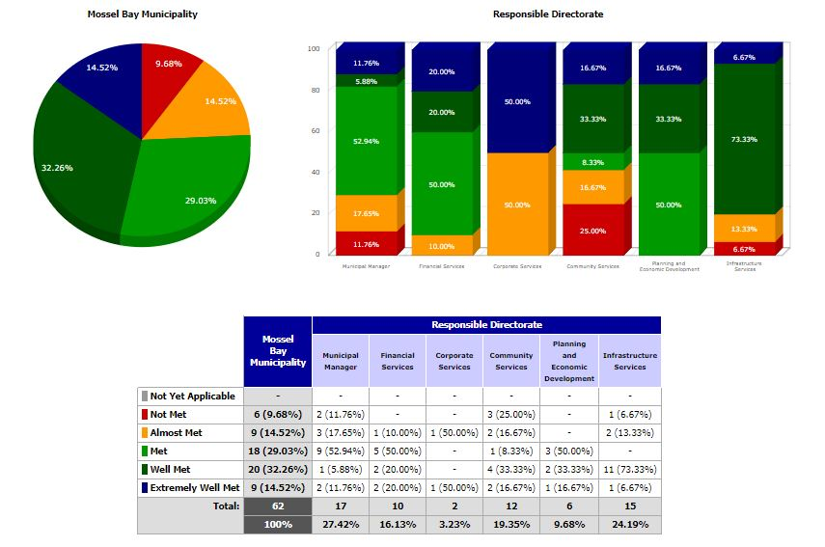
2019/2020 Annual Performance
NB: Following scores are based on unaudited performance
Municipal Performance

Slide 6
2019/2020 Annual Performance
MM | Financial Services | Corp Services | Comm Services | Pln & Eco Dev | Infra. Services

Slide 7
2019/2020 Annual Performance

Slide 8
MAJOR INFRASTRUCTURE PROJECTS 2020/2021
(>R2 OOO OOO BUDGETED)
Electricity
Project | Ward | Budget allocation
Upgrade of Dana Bay Substation | 11 | R3 750 000
MV Extension to Hartenbos Landgoed Area | 4 | R4 815 000
MV Network improvement 22 to 11 Kv | Multi | R3 978 000
Streets and Stormwater
Project | Ward | Budget allocation
New S/W Bakke/Mossel Street Watercourse | Multi | R2 500 000
New link road from Walvis/Hall Street to Terrence Ndanda | 12 | R3 728 000
Upgrade Municipal Main Road MR348: Long Street & Station Road Great Brak-River | 4 | R17 391 304

Slide 9
Streets and Stormwater Continued…
Project | Ward | Budget allocation
Municipal Main Road MR348 Gbr: Construct various Infrastructure | 4 | R7 618 206
Water and Sewerage
Project | Ward | Budget allocation
Refurbishment of Regional WWTW | Multi | R3 252 184
Upgrade of Water Supply Pipeline from Little Brak WTW to Langeberg Reservoirs | Multi | R6 000 000
Replace Water Network Lines-All Areas | Multi | R3 552 350
Upgrade Herbertsdale Water Reticulation | 7 | R3 118 963
New Reservoir @ Farm Vaale Vallei | Multi | R7 680 000

Slide 10
Water and Sewerage
Project | Ward | Budget allocation
Drilling, testing,equipping and connection of boreholes in Herbersdale and Buisplaas | Multi | R2 200 000
Community Safety
Project | Ward | Budget allocation
New Control room | Admin | R3 700 000
Human Settlements
Project | Ward | Budget allocation
Upgrading of Informal Settlements | 3 | R15 000 000

Slide 11

Support Required/ Areas of Collaboration
SAPS: New police station at Kwanonqaba – Ward 1
DoBE: New secondary School for wards 1,2,3,11 and 13 areas
DCAS: Library Services (Reebok Tergniet) - Ward 4
DoH: Mobile Clinic for Jonkersberg Rural Settlement – Ward 5.
TNPA: Harbour and Waterfront Development – Ward 8
DEDAT: Formalisation of Informal Traders – All Wards
DOE/ ESKOM: Solar Geyser Project Completion: All wards (poor households)
DoH: Expansion of Alma Clinic – Ward 13
Same as last time, please.

Slide 12
Thank You

