Slide 1
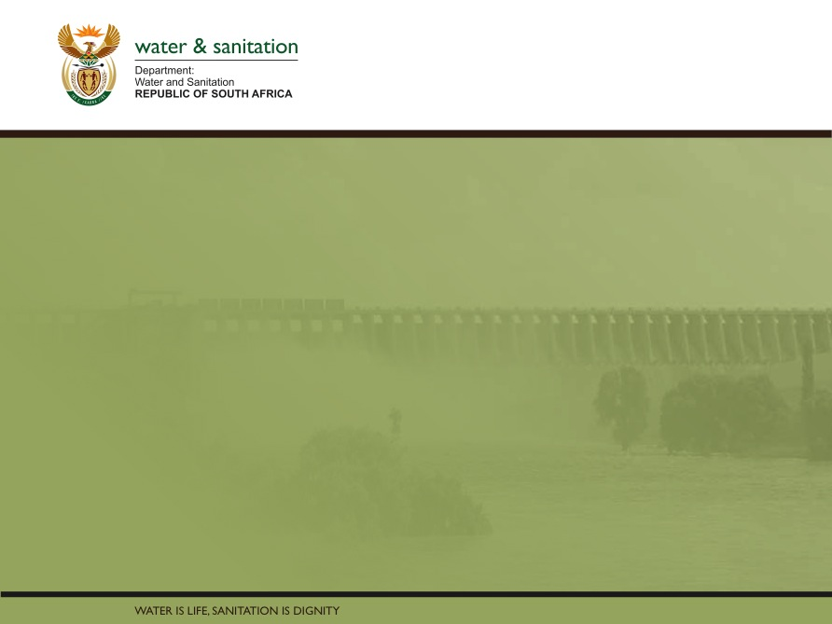
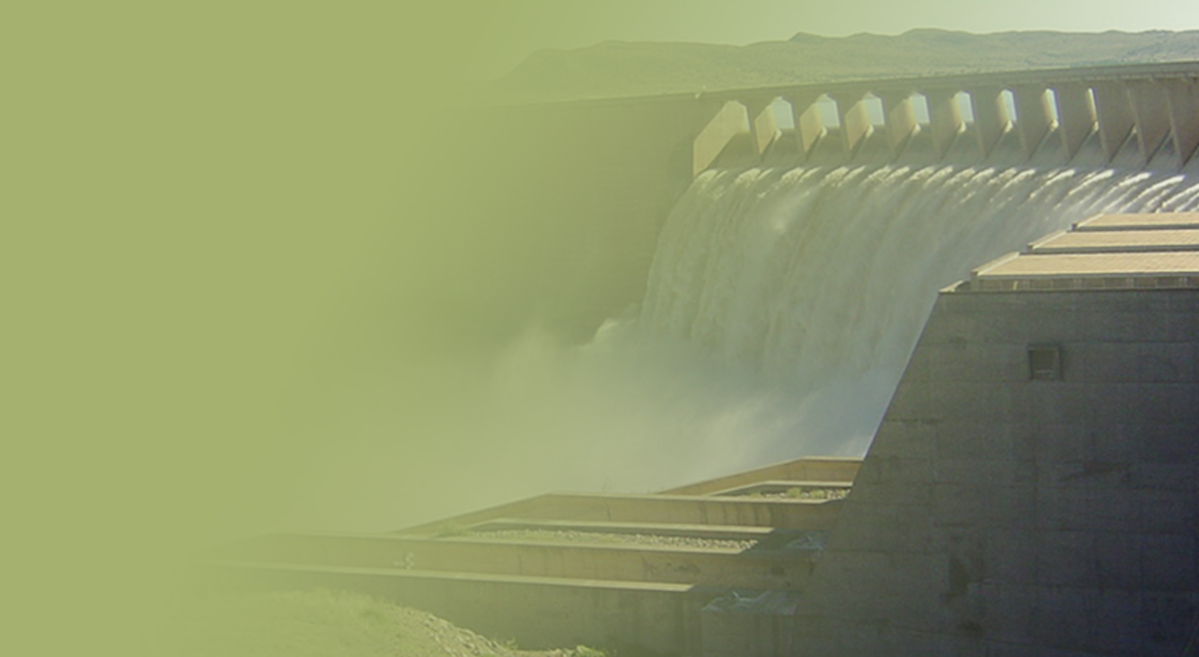
PRSENTATION ON THE STATUS OF PROJECTS IN THE GARDEN ROUTE AREA
Presentation by
Zolile Simawo
DATE: 24 NOVEMBER 2020
PRESENTATION TITLE
Presented by:
Name Surname
Directorate
Date

Slide 2
GARDEN ROUTE DISTRICT OVERVIEW
The Garden Route District(GR) is performing well in terms of the current levels of access to water and sanitation services. The Annual Water Services Development Plans Performance and Water Services Reports for all Water Services Authorities in GR reveal that most of the Water Services Authorities are meeting the minimum standards for access to water and sanitation services.
Moreover, in most of the WSAs, over 95% of their population have adequate access to water and sanitation services, while over 85% of their population have access to adequate sanitation services and these figures are consistent in all WSAs.

Slide 3
DWS CONTRIBUTION TO THE GARDEN ROUTE
  The DWS is implementing a number of programmes and projects towards socioeconomic upliftment of communities within Garden Route District. These programmes & projects include the advocacy & awareness programmes as well as infrastructure build programmes.
  (a). Advocacy & awareness Programme
  Massive water conservation awareness programmes for schools within the Garden Route – 2020VFWSEP
    Hibernia & Heidedal Primary Schools, media classroom
    Knysna, Percy Mdala & George High Schools – provided bursaries as part of careers in water & environment
  Massive water conservation, environmental & H&H education programmes for schools and communities within the GR – Ms Earth SA
  Multistakeholder engagements – IGR & Sector Collaboration
  Partnership with media houses to spread to word of water conservation across the GR region, Eden FM & George Herald
  Partnership with private sector, e.g. Cobra
  Capacity building programmes for communities through Water & sanitation forums

Slide 4
(B). INFRASTRUCTURE BUILD PROGRAMMES
The DWS is currently implementing a number of infrastructure projects which are funded from different streams of programmes. These projects include:
Water and Sanitation Infrastructure Grant – Refurbishment or extension/expansion of water & sanitation infrastructure (WC/WDM)
Regional Bulk Infrastructure – new bulk infrastructure – reticulation
Municipal Infrastructure Grant – water & sanitation infrastructure
National Water Infrastructure – Dam Construction, etc.
Ground water abstraction projects – augmentation of water supply systems, Kannaland Municipality boreholes
Drought Intervention Projects - Oudtshoorn
Supply of COVID-19 water tanks to all WSAs in the District
COVID-19 Health & Hygiene Material
Currently identifying new projects for the MTEF

Slide 5
Garden route district municipality
Infrastructure projects funded through
Regional bulk infrastructure grant
Water services infrastructure grant
Drought intervention projects

Slide 6
2020/21 Regional Bulk Infrastructure Grant Allocations
Water service authority | Project name | Projects status | Population | Driver | 2020/21 allocation in R’000
Garden Route | N/ A

Slide 7
2020/21 Water Service Infrastructure Grant Allocations
Local municipality | Project name | 2020/21 allocation in R’000
Kannaland | Deep borehole in Calitzdorp | 10 000
Oudtshorn | Klein Karoo Scheme | 10 000
Total for WSIG 5 B allocation |  | 20 000

Slide 8
2019/20 Water Service Infrastructure Grant projects to be completed during 2020/21
Local municipality | Project name | 2019/20 allocation in R’000
Kannaland | Calitzdorp replacement of asbestos pipeline | 10 000
Oudtshoorn | Replace internal pipework/valves, fittings, etc at Water Treatment Works. Refurbish/replace pumps and blowers. Replace outdated electrical gear, fittings and control mechanisms (telemetry) Replace filter material. Refurbishment of mechanical and electrical equipment. Installation of telemetry control system to manage, operate and monitor the KKRWSS from the Technical Offices in Oudtshoorn. Repair house nr. 2 at the Dysselsdorp Water Treatment Works which was damaged in a fire. | 10 000

Slide 9
Drought intervention
Activity | Roll over Budget R'000 | Spent 'R'000 | IA
Blossoms emergency pipeline | 30,000 | 30,000 | Oudtshoorn
Total | 30 000 | 30,000

Slide 10
WATER TANKS ALLOCATED TO THE GARDEN ROUTE AS PART OF COVID-19 INTERVENTION
132 water tanks were allocated to 7 municipalities in the Garden Route
Local Municipality | Number of tanks allocated | Number of tanks delivered , installed, verified | Number of Tanks to be verified
Knysna | 21 | 21
George | 46 | 40 | 6
Bitou | 13 | 13
Oudshoorn | 10 | 10
Mossel Bay | 16 | 19
Hessequa | 13 | 13
Kannaland | 13 | 13

Slide 11
COVID-19 PHASE 2
Municipal Area | No of Covid Phase 2 tanks to be implemented | Estimated Budget | Running RBIG Project | Existing IA to be appointed
Oudtshoorn | Water Tanks installed. The need is construction of water reticulation and installation of stand pipes in Buffelsdrift, Lateganvlei, Golf Course Informal Settlement, Blossoms; Safari and De Hoop | R3 250 500,00 | Yes but still on planning phase | Oudtshoorn

Slide 12
Proposed New RBIG Projects
Project Name | Town | Total Budget
Ladismith WWTW upgrading: Currently polluting river | Ladismith | R100 000 000
Ladismith Deep Borehole project | Ladismith | TBC
Swartberg Dam | Ladismith | R300 000 000
Knysna & Bitou Cross boarder water supply | Knysna | TBC
Blossoms Project | Oudtshoorn | R50 000 000

Slide 13
Dam Levels
Dam | Date | % Full This Week |  | % Full Last Week | % Full Last Year
Cape Town System Dams Consist of : Wemmershoek-; Voëlvlei-; Steenbras Upper and Lower- ; Theewaterskloof Dam and Berg River Dam
Cape Town System Dams (Combined) | 23/11/2020 |  | 98,78 | 99,34 | 82,62
Berg River Catchment | 23/11/2020 |  | 96,91 | 97,62 | 92,96
Breede River Catchment | 23/11/2020 |  | 84,56 | 85,07 | 64,07
Gouritz River Catchment | 23/11/2020 |  | 24,45 | 24,04 | 17,94
Olifants / Doorn River Catchment | 23/11/2020 |  | 94,60 | 96,40 | 82,69
Western Cape State of Dams | 23/11/2020 |  | 79,47 | 80,03 | 65,23

Slide 14
Thank you

