Slide 1


GARDEN ROUTE DISTRICT IDP REPRESENTATIVE FORUM
24 November 2020
DEPARTMENT OF HUMAN SETTLEMENTS
Prepared by: Richard Jordan
Regional Planner: Garden Route & Cape Town
Directorate: Planning

Slide 2
STATUS OF 2020/21 PROJECTS WITHIN GARDEN ROUTE DISTRICT
Overview: 2021/22 Business Plan Budget Allocation (All Regions):

Slide 3
STATUS OF 2020/21 PROJECTS WITHIN GARDEN ROUTE DISTRICT
Overview of HSDG + UISP Allocation across GR municipalities:

Slide 4
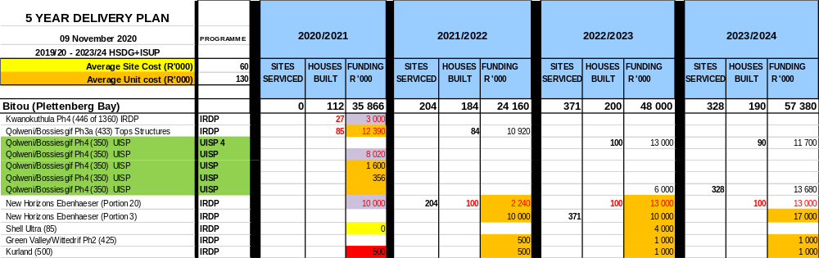
STATUS OF 2020/21 PROJECTS WITHIN GARDEN ROUTE DISTRICT
Bitou Projects:
20/21 Budget: R 35.86M
21/22 Budget: R 24.16M

Slide 5
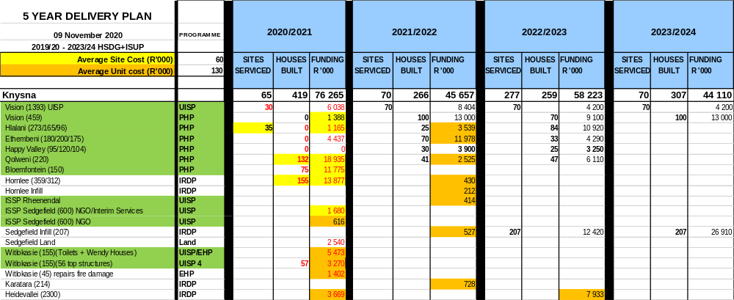
STATUS OF 2020/21 PROJECTS WITHIN GARDEN ROUTE DISTRICT
Knysna Projects:
20/21 Budget: R 76.26M
21/22 Budget: R 45.65M

Slide 6
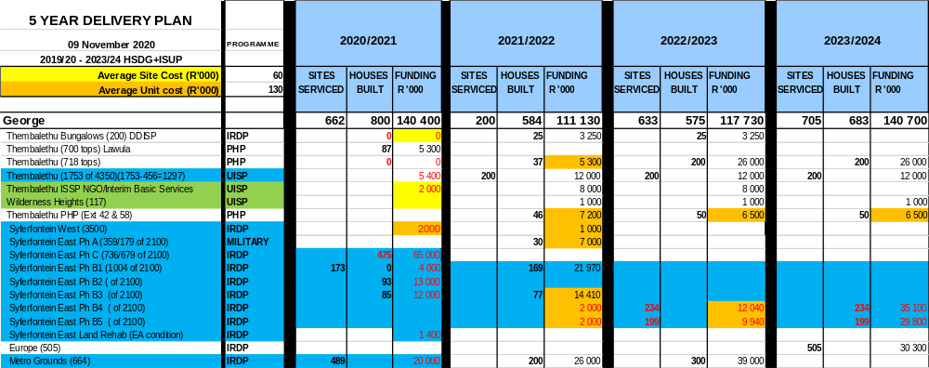
STATUS OF 2020/21 PROJECTS WITHIN GARDEN ROUTE DISTRICT
George Projects:
20/21 Budget: R 140.40M
21/22 Budget: R 111.13M

Slide 7
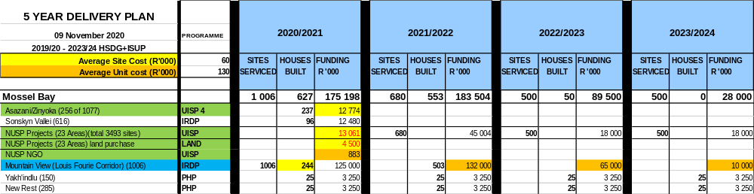
STATUS OF 2020/21 PROJECTS WITHIN GARDEN ROUTE DISTRICT
Mossel Bay Projects:
20/21 Budget: R 175.19M
21/22 Budget: R 183.50M

Slide 8
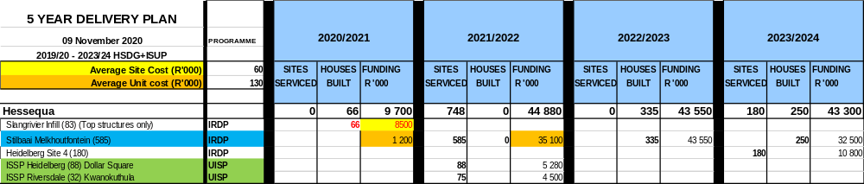
STATUS OF 2020/21 PROJECTS WITHIN GARDEN ROUTE DISTRICT
Hessequa Projects:
20/21 Budget: R 9.70M
21/22 Budget: R 44.88M

Slide 9
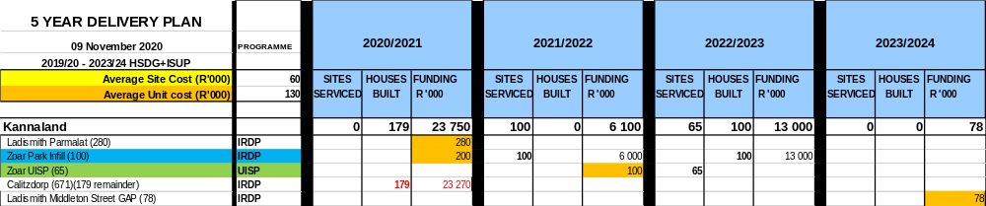
STATUS OF 2020/21 PROJECTS WITHIN GARDEN ROUTE DISTRICT
Kannaland Projects:
20/21 Budget: R 23.75M
21/22 Budget: R 6.10M

Slide 10
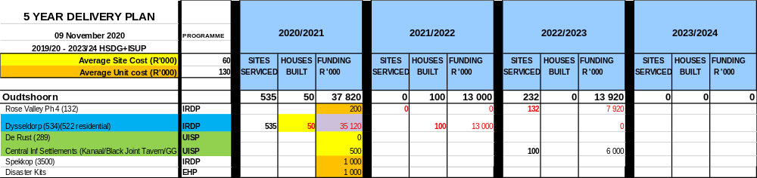
STATUS OF 2020/21 PROJECTS WITHIN GARDEN ROUTE DISTRICT
Oudtshoorn Projects:
20/21 Budget: R 37.82M
21/22 Budget: R 13.00M

Slide 11
CHALLENGES AND POSSIBLE SOLUTIONS
Revised National Government Business Planning Directive 30 Sep 2020:
Downscale Top Structures
Prioritise Sites
Shift to densification
Prioritisation of Beneficiary Selection
Elderly
Child Headed Households
Disabled
Backyarders
Longest on the waiting list
Military Veterans

Slide 12
CHALLENGES AND POSSIBLE SOLUTIONS
CHALLENGES | POSSIBLE RESPONSE
Land availability | Densification Land assembly strategies Land swops Expropriation is an option at local municipal level Rapid Land Release Program
Lack of financial resources | Shift to site and services approach Commit to realistic targets and manage expectations with communities Partnership between the Private Sector and the Public Sector Consider alternative building material technology in the development of top structures
Lack of Capacity | HS planning Better IGR between all three spheres of Government Possible partnerships with the Private Sector to expedite pre-planning, planning and packaging of projects
Bulk Services Availability | Integrated master planning Maximise on existing bulk services Prioritise MIG funding for housing with integrated projects Adopt alternative basic service provision technology such as on site packaging plants or other more innovative technological solutions

Slide 13
2021/22 PROGRAMMES THAT PRIORITIZE SAFETY, JOBS, DIGNITY AND WELL-BEING
Informal Settlement Support Plan (ISSP):
The support to municipalities and related informal settlement communities falls under the policy framework of the National Upgrading of Informal Settlement Programme (UISP) and the provincial ISSF approach.
NGO’s have also been appointed under the NGO Framework Agreement (working in conjunction with the Municipal Project Steering Committee, Municipal Housing Manager, technical consultants and informal settlement communities) to assist with:
Enumerations,
Community-based planning, and
Social facilitation (including leadership training capacity-building, and conflict mediation).

Slide 14
2021/22 PROGRAMMES THAT PRIORITIZE SAFETY, JOBS, DIGNITY AND WELL-BEING
SUPPORT TO GARDEN ROUTE DISTRICT MUNICIPALITIES:
Bitou, Mossel Bay, Knysna and George Municipality:
NGO contracts in place in Bitou, Mossel Bay, Knysna and awaiting initiation in George Municipality due to community issues yet to be resolved.
However, the Department supports all Western Cape Municipalities via various other means and channels of which the other municipalities benefit from:
1) Through the Quarterly ISSP Forums, hosted by the Department, Garden Route District Municipalities have been exposed to different capacity-building initiatives and best practice examples of the upgrading of informal settlements; and
2) During the initial Covid-19 Lockdown Levels, the Department offered all municipalities the chance to identify capacity gaps:
A Municipal Survey (conducted prior to the May ISSP Forum), assessed the following issues: Covid-19 water tank delivery and installation delays, sustainability thereof, vandalism of tanks, sanitation requirements, land invasions, janitorial services, waste removal and NGO support. All the Garden Route District municipalities provided feedback; and
A subsequent mini-ISSP Forum (held in June), hosted on behalf of the Department of Water and Sanitation and the Department of Local Government, surveyed all Municipalities on Water Supply, Sanitation and Janitorial Services, to which all the Garden Route Municipalities responded in detail, identifying sanitation ratios as a challenge to be addressed.

Slide 15
WAY FORWARD
Realign human settlements planning to new policy directives
Municipalities should start to review and re-write their allocations policy in line with this
DoHS will provide guidance to this in the New Year
Minister has directed the DoHS to have a new delivery model for the Department by September 2021
Strategic planning (SDF’s and HSP’s) to give better direction to spatial targeting
Utilise PHSHDA’s to more effectively coordinate Human Settlements/Housing initiatives (spatial targeting)

